Slide 1
Configuration Guide
(IDE – Eclipse 3.5 Project Preferences)
2009. 07. 20
CODELABOR
Shin Sang Jae (codelabor@gmail.com)

Slide 2
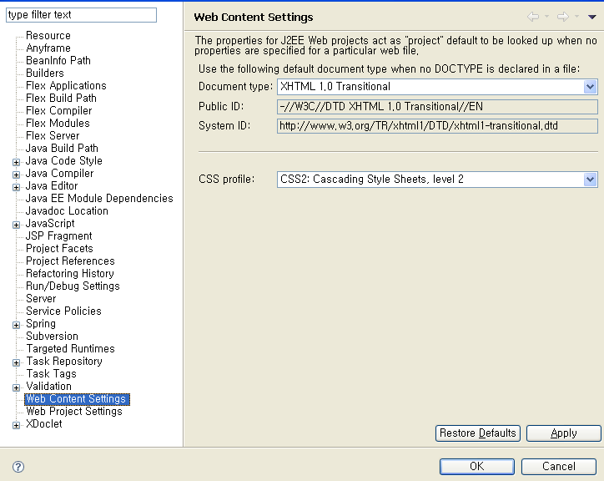
Web Content Settings
Web Content Settings
Project ＞ Preferences > Web Content Settings
Document Type: XHTML 1.0 Transitional
CSS profile: CSS2: Cascading Style Sheets, level 2

Slide 3
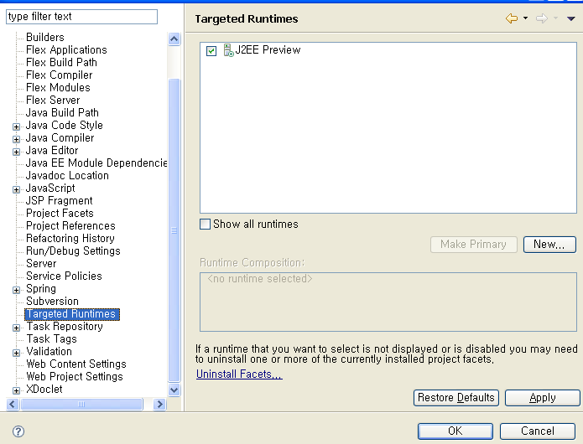
Targeted Runtimes
Targeted Runtimes
Project ＞ Preferences > Targeted Runtimes
J2EE Preview

